Slide 1
GOOD THERAPY
Presented by Liz Powell and Sonia Wagner
25 August 2021

Slide 2
GOOD THERAPY
WHEN?
Life Changes – divorce, death, catastrophes, stress, physical health
Goals – relationships, social skills, behaviour (ADHD/ASD), education and development, rehabilitation and physical health
Mental Health – depression
WHO?
Talk with GP or Paediatrician
Trained and Licensed – social worker, psychologist, psychotherapist, psychiatrist
Trauma Informed
Specialised Training

Slide 3
PSYCHOLOGIST
Australian Psychological Society peak body
Licenced by Psychology Board of Australia
6 year degree (including 2 years experience)
A science of how people think, feel, behave and learn
Clinical , neuro, community, counselling, educational and developmental, forensic, organisational, health, sport and exercise
SOCIAL WORKER
Licenced clinical
Degree + 2 years experience
Individual, family or couples therapy
Community health , education, aged care, alcohol and drugs, refugee facilities, aged care
Service referral and advocacy
PSYCHIATRIST
Attend medical school 4-6 years plus 1 year+ training + specialist training 5 years+
Can administer medications plus psychological treatment
Licenced by AHPRA and member of RANZCP
Suicidal, Delusional, Childhood anxiety or disorders
COUNSELLOR
May not be degree qualified
Australian Counselling Association – diploma or higher
Can be short term focused and involves guidance and support
Addiction, marriage, eating, phobias
TYPES OF PROFESSIONALS
OCCUPATIONAL THERAPIST
Registered AHPRA and member of OTAustralia
Self care health and wellbeing, disability
PSYCHOTHERAPIST
A counsellor also
Talk therapist, feeling and experience focused for long term
Utilises other therapeutic strategies
Psychotherapy training is generally self regulated in Australia
Member of Australian Counselling Association and Psychotherapy & Counselling Federation of Australia
Grief, Loss, Trauma
THERAPIST
Physical, mental and emotional wellbeing
Not outcome focused when using art, clay or other mediums
Equine (Psychotherapy Institute Australia ) and dogs/animals (Animal Assisted Therapy)

Slide 4
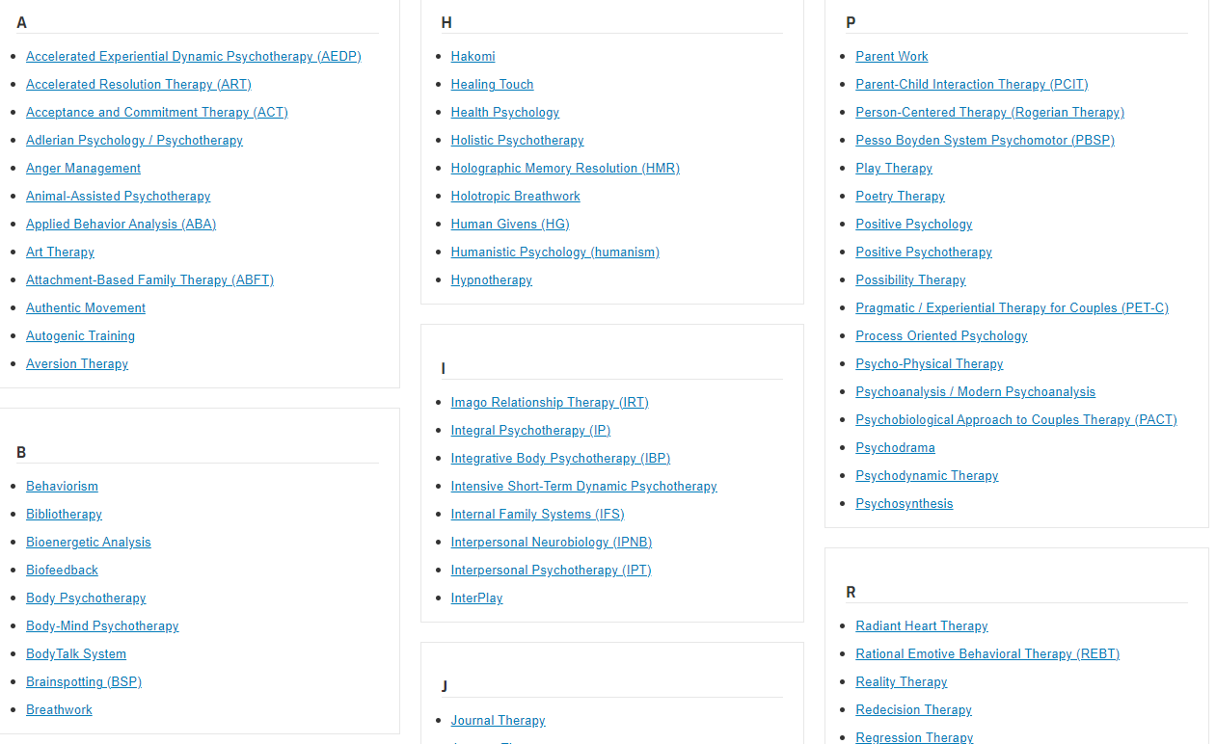
SO MANY THERAPISTS! GOOD THERAPY.ORG

Slide 5
QUESTIONS TO ASK
Who are you licensed with
How much experience do they have working with families formed by adoption, kinship or permanent care
Are you trauma informed and how much experience do you have with this
Child led or therapist led
Specialised training
Location
Individualised or group based, in person or online, is crisis support offered
Parent and child involvement or both
Frequency, commitment and homework
What happens in the first session / assessment
How do you set goals and what does success look like (and how long might that take)
Appointments available or how long a wait
Fees and funding options via NDIS, Medicare or elsewhere (including cancellation policy)
What were your reasons for becoming a therapist
How do you think you can help me
What are your triggers
Where do you get support or supervision yourself
Do you feel heard, respected and optimistic after speaking with them: someone to share youth feelings and thoughts with

Slide 6
TRAUMA INFORMED THERAPIES -
Animal or Equipne Therapy
Safe and Sound Protocol Therapy
Polyvagal or Safe and Sound Protocol
Art Therapy
Somatic Therapy
Sensorimotor Therapy
Child Caregiver Psychotherapy
Trauma Focused Cognitive Behavioural Therapy
Neuro Developmental Therapy
Sensorimotor Therapy
Trauma informed means:
- Aware of impact and recovery pathways
- Recognise signs and symptoms of trauma
- Respond with trauma informed practice
- Avoid retraumatisation
Cognitive Processing Therapy
Speech Therapy
NET Narrative Exposure Therapy
Attachment and Self Regulation
Neurosequential Therapy
WHAT HAPPENED TO YOU NOT WHATS WRONG WITH YOU
Life Story Therapy
Occupational Therapy
EMDR Therapy
Play Therapy
Gestalt Therapy

Slide 7
RESOURCES
Good Therapy Australia –
https://www.goodtherapy.com.au/flex/types-of-therapists/906/1
Berry Street Therapeutic Services –
https://www.berrystreet.org.au/what-we-do/trauma-services/therapeutic-services-for-children-young-people-and-families
Raising Children –
https://raisingchildren.net.au/guides/a-z-health-reference/psychologist
Supporting Brain Development in Traumatised Children – evidence based intervention treatments
https://www.childwelfare.gov/pubPDFs/braindevtrauma.pdf
Lancaster Consulting and Carer Kafe – From Diagnosis to Support –
file:///C:/Users/SoniaWagner/AppData/Local/Microsoft/Windows/INetCache/Content.Outlook/TNC806C4/CarerKafe%20Handout%20-%20Resources%20From%20Diagnosis%20to%20Support%20v2%202020.pdf
Notes:
1- Insert Picture >> Format >> Send to Back
2- Add Quote >> Add Author/Writer >> Adjust text to suit image

