Slide 1
NDIS DESIGN
Tips and Shared Learnings
Presented by Liz Powell and Sonia Wagner 28/7/21

Slide 2
THE INDIVIDUAL WITH THE DISABILITY IS THE FOCUS – THE PARTICIPANT

Slide 3
The Individual with the Disability is the Focus – The Participant
BEING
THE CHILDS REPRESENTATIVE:

Slide 4
ELIGIBILITY FOR PERMANENT AND SIGNIFICANT DISABILITY
Under 7
Developmental delay or disability
Work with an ECEI partner
Aged 7-65
Look at residency and disability
Permanent and significant disability: support now or reduce future needs
Work with a Local Area Coordinator
Search by suburb for ECEI or LAC:
https://www.ndis.gov.au/contact/locations/-37.7295%2C144.7371/50/5003

Slide 5
REASONABLE AND NECESSARY SUPPORTS
Assist social and economic participation
Value for money in terms of costs vs benefits
Effective and beneficial for participant, considering good practice
Reasonable to expect families, carers, informal networks and the community to provide
Appropriately funded through NDIS vs through other systems or supports
Covid-19 doesn’t mean more funding, but funding can be reallocated eg from capacity building to fix walls from meltdown damage
Consider: social isolation, risks to child and others, to health and wellbeing or to sustainability of care within the home

Slide 6
National Disability Insurance Scheme FUNDING SUPPORT See NDIS Plan Budget and Rules
CORE SUPPORTS
- SELF CARE SUPPORT WORKERS
- Respite
- Camps
- Classes
- Vacations
- Support coordination and plan management
CAPACITY BUILDING TO PARTICIPATE IN THE COMMUNITY
- THERAPY SUPPORT
-POSITIVE BEHAVIOUR SUPPORT
- Peer support
- Counselling and training for child, carer and family members
CAPITAL SUPPORTS
- ONE OFF PURCHASES
ASSISTIVE TECHNOLOGY
- HOME MODIFICATIONS
- COMMUNICATION DEVICES
SELF MANAGED – LOCAL AREA COORDINATOR or early childhood partner ASSISTS PARTICIPANT, gives control and flexibility, can check workers on the ndis worker screening clearance
Plan manageD – NDIA will provide funding for plan manager (provider), service agreement
Ndia managed – ndia manage and pay registered providers electronically

Slide 7
FUNDING SUPPORT
CORE SUPPORTS (CATEGORY 1 TO 4, MOST FLEXI BLE FUNDS)
1. DAILY LIVING: MEALS, GARDENING, SHOWERING, DRESSING, RESPITE
2. TRANSPORT IF CANT USE PUBLIC TRANSPORT (PAID BY NDIA OR PLAN MANAGER)
3. CONSUMABLES: NUTRITION, CONTINENCE, SMARTPHONE IPAD, SENSORY EQUIPMENT, ASSISTANCE DOG INSURANCE AND GROOMING, AUSLAN. CONSULT AN OT
4. SOCIAL AND COMMUITY PARTICIPATION EG NOT CONCERT TICKET BUT FOR SUPPORT WORKER TO ATTEND A CONCERT
CAPACITY BUILDING TO PARTICIPATE IN THE COMMUNITY (category 7 to 15)
7. Support coordination: therapy, behaviour, peer support, counselling and training and support coordination from plan partners
8. Living arrangements: accommodation, transitioning to independent living eg going to inspections
9. Social & community participation: links to category 4 support worker, activities such as life skills training or sports coaching, mentors
10. Finding & keeping a job: get or keep a job, resume and interview supports
11. Improved relationships: psychology, social building skills, behavioural therapy
12. Improved health & wellbeing dieticians, exercise physiologists, personal trainers:
13. Improved learning: school to further education, advice, applications
14. Improved life choices: financial and organizational skills, plan management
15. Improved daily living: exercise physiology, assessments, reports, physio, ot, speech therapy, ec intervention
CAPITAL SUPPORTS (CATEGORY 5 AND 6)
- ONE OFF PURCHASES AND REPAIRS
5. Assistive tech: WHEELCHAIRS, PROSTHETICS, VEHICLE MODIFICATIONS, BRAILLE RESOURCES, GUIDE DOG
6. Home mods: rails, ramps, project manager to implement, specialist disability accomModation
QUOTE FROM PROVIDER AND ASSESSMENT FROM THERAPIST

Slide 8
PROCESS
PRE PLAN
Carer Statement
Request Support Coordination and Plan Management
Request Respire and supports to make sustainable
PLAN AHEAD
Take someone for support
NDIS booklet and glossary: Reasonable and Necessary, Functional Capacity, Core Support, Capacity Building, Local Area Coordinator (LAC), NDIA Delegate
Don’t normalize everyday needs
Put everything in writing at the meeting for NDIS decision maker who isn’t at the meeting
GOALS:
Outcomes based not specific supports Flexible enough to change
For example, spend more time in the community and become more confident NOT to attend a day program
EVIDENCE:
GP, Paediatrician, Therapist, School Reports, Service Refusal
Participant Statement
Carers Statement
Three Short Term Goals
Two Long Term Goals

Slide 9
ACCESS
Access request form
28 pages applicant/legal rep and treating professional
Local area coordinator can help
Length of disability and available treatments
treating professional
gp, paediatrician, surgeon, occupational therapist, speech therapist, neurologist, psychologist, psychiatrist, physiotherapist
6 months of treatment +
Most appropriate person for primary disability
Psychosocial disability form
Impairment to physical, sensory or mental function (Perception, thinking and emotions)
Psychosocial recovery coach has mental health knowledge
cert 4 & 2 years experience paid mental health work
prefer single support: support coordinator or recovery coach
REVIEW DECISION Can request formal review of decision
Or
Gather new evidence and request reassessment within 3 months
Or
after 3 months a new request can be made with ndia

Slide 10
PARTNERS
Brotherhood of st Laurence
Melbourne metro
Bayside, hume moreland, brimbank melton, north east, western
Latrobe community health
Melbourne metro
Inner east, outer east, southern
Regional
Barwon, central highlands, inner Gippsland, outer Gippsland, ovens murray, wimmera south west
intereach
Regional
Loddon, Goulburn, mallee
link health and community
Melbourne metro
Outer east, inner east, southern
Regional
Inner Gippsland, outer gippsland
MERRI HEALTH
Melbourne METRO
North East
Regional
Ovens murray
Barwon child, youth and family
Regional
barwon
LaC PARTNERS
Ecei PARTNERS
intereach
Regional
Loddon, Goulburn, mallee
Brotherhood of st Laurence
Melbourne metro
Bayside, hume moreland, brimbank melton, north east, western
Latrobe community health
Melbourne metro
Inner east, outer east, southern
Regional
Barwon, central highlands, inner Gippsland, outer Gippsland, ovens murray, wimmera south west

Slide 11
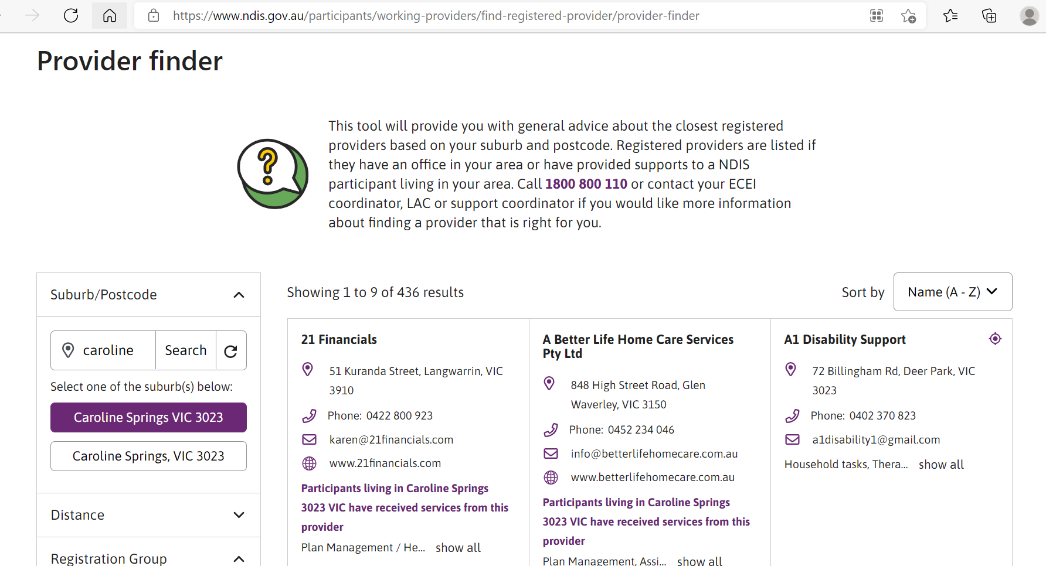
PROVIDER FINDER Provider finder | NDIS Not all providers need to register Self managed plans

Slide 12
GUIDES AND REVIEW PROCESS Pricing arrangements | NDIS
Pricing Arrangements and Price Limits designed for value for money, maximums for registered providers (NDIS Managed or Plan Managed)
Review
Within 3 months of decision notice
After that, new application
1800 800 110 or enquiries@ndis.gov.au
Request initial review for reviewable decisions
Review Application Form
AAT
If a review fails, you can go to the Administrative Appeals Tribunal
1800 228 333
Complaints – 21 days to resolve
feedback@ndis.gov.au
Covid Addendum
Support Catalogue
Other Specialist Guides
eg home modifications, specialist accomodation

Slide 13
RESOURCES
https://www.cfecfw.asn.au/ndis-resources/
Support to prepare for your NDIS planning meeting – Yooralla
The Knowledge Centre | Get NDIS confident with Plan Partners
National Disability Insurance Scheme (NDIS)
NDIS | Association for Children with Disability (acd.org.au

